Slide 1
A Statistical Approach to Ultrasonic Inspection in Complex Geometry
Matt Chandler – m.chandler@bristol.ac.uk
Supervisors:
Prof. Anthony Croxford & Prof. Paul Wilcox

Slide 2
Overview
Introduction
  Motivation
  Statistical framework
Multivariate statistics
  Wrinkling in CFRP
  Hypothesis testing
Conclusions
1

Slide 3
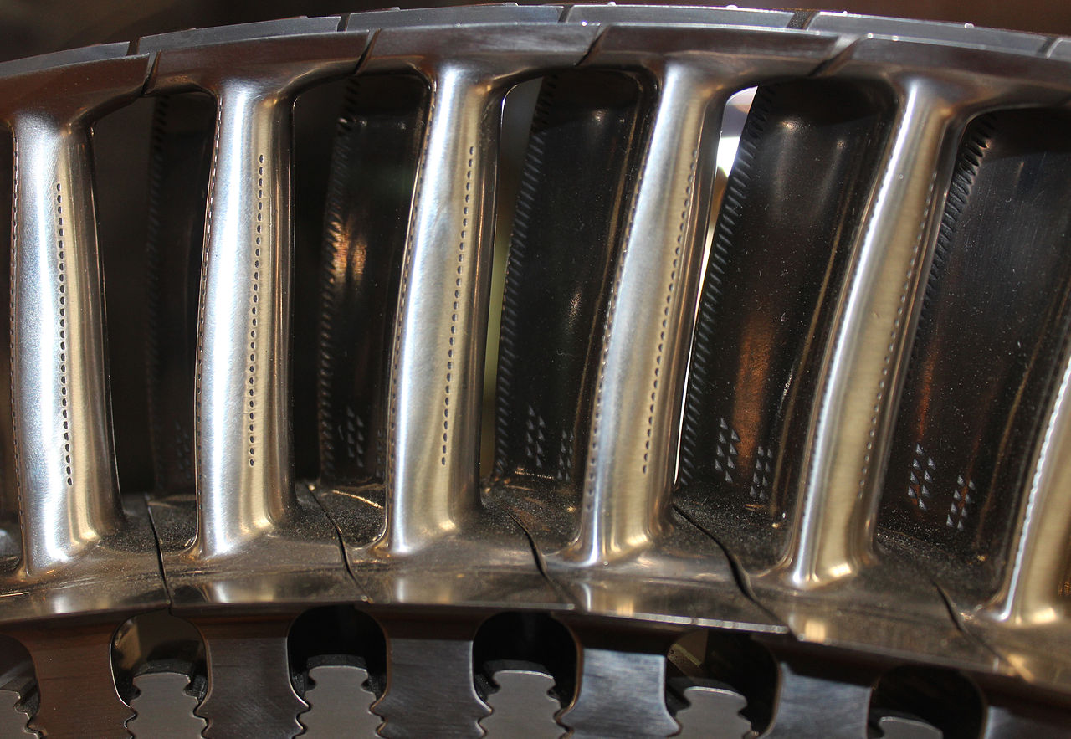
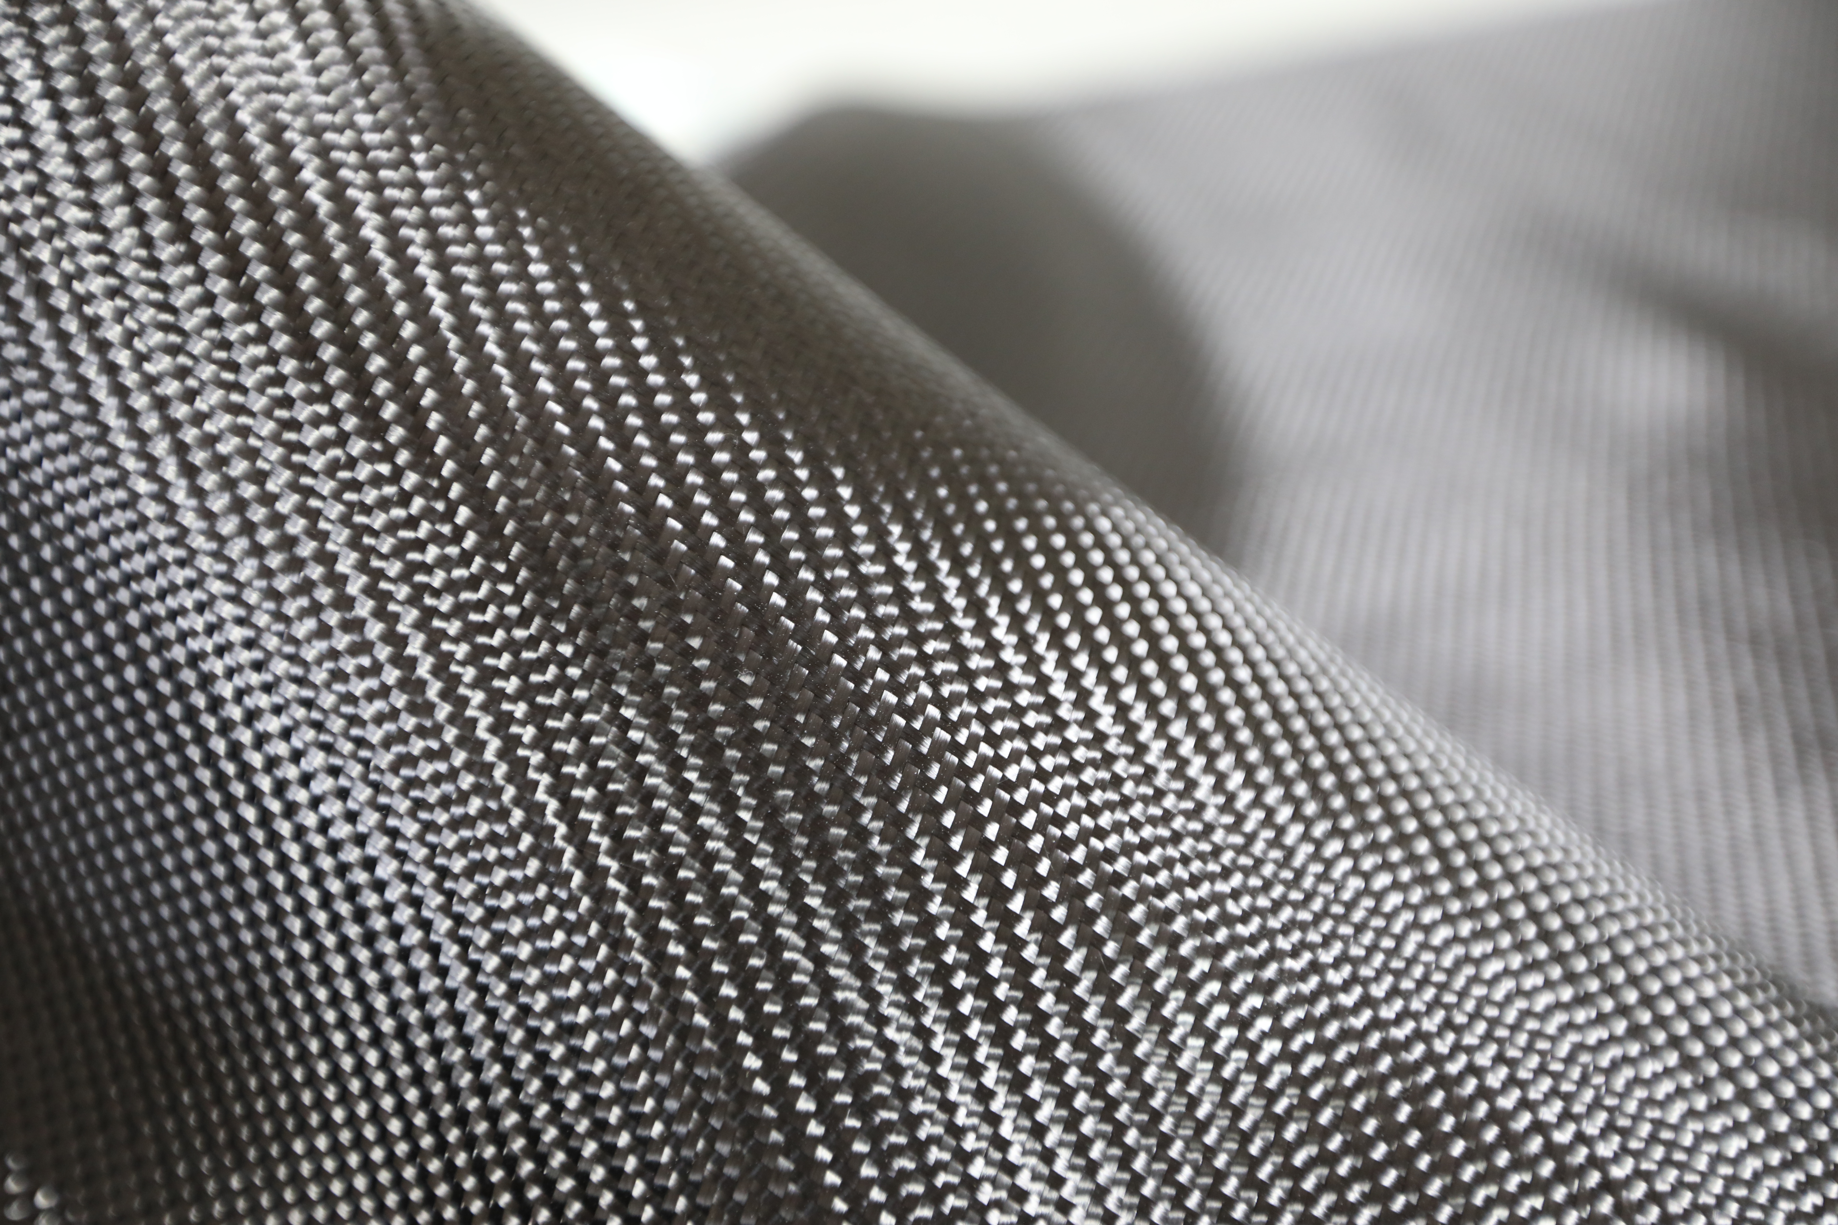
Motivation
Geometrical complexity
Structural complexity
[1] | Michael Pätzold, CC BY-SA 3.0, via Wikimedia Commons
[2] | Duboyong, CC-BY-SA-4.0, via Wikimedia Commons
2

Slide 4
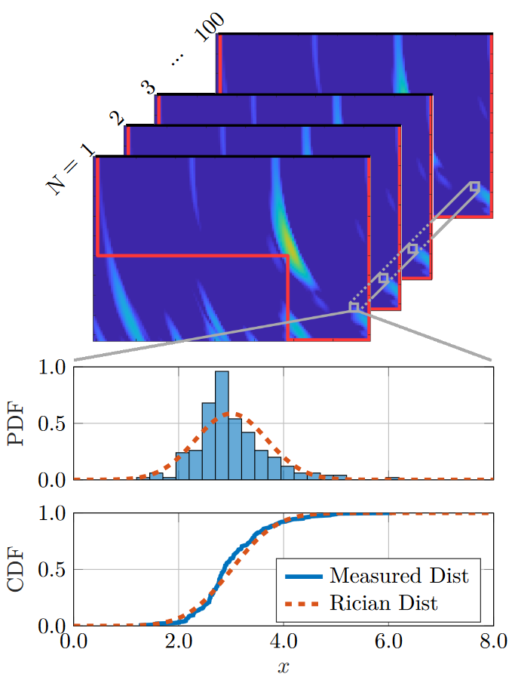
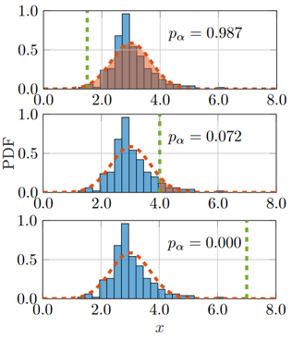
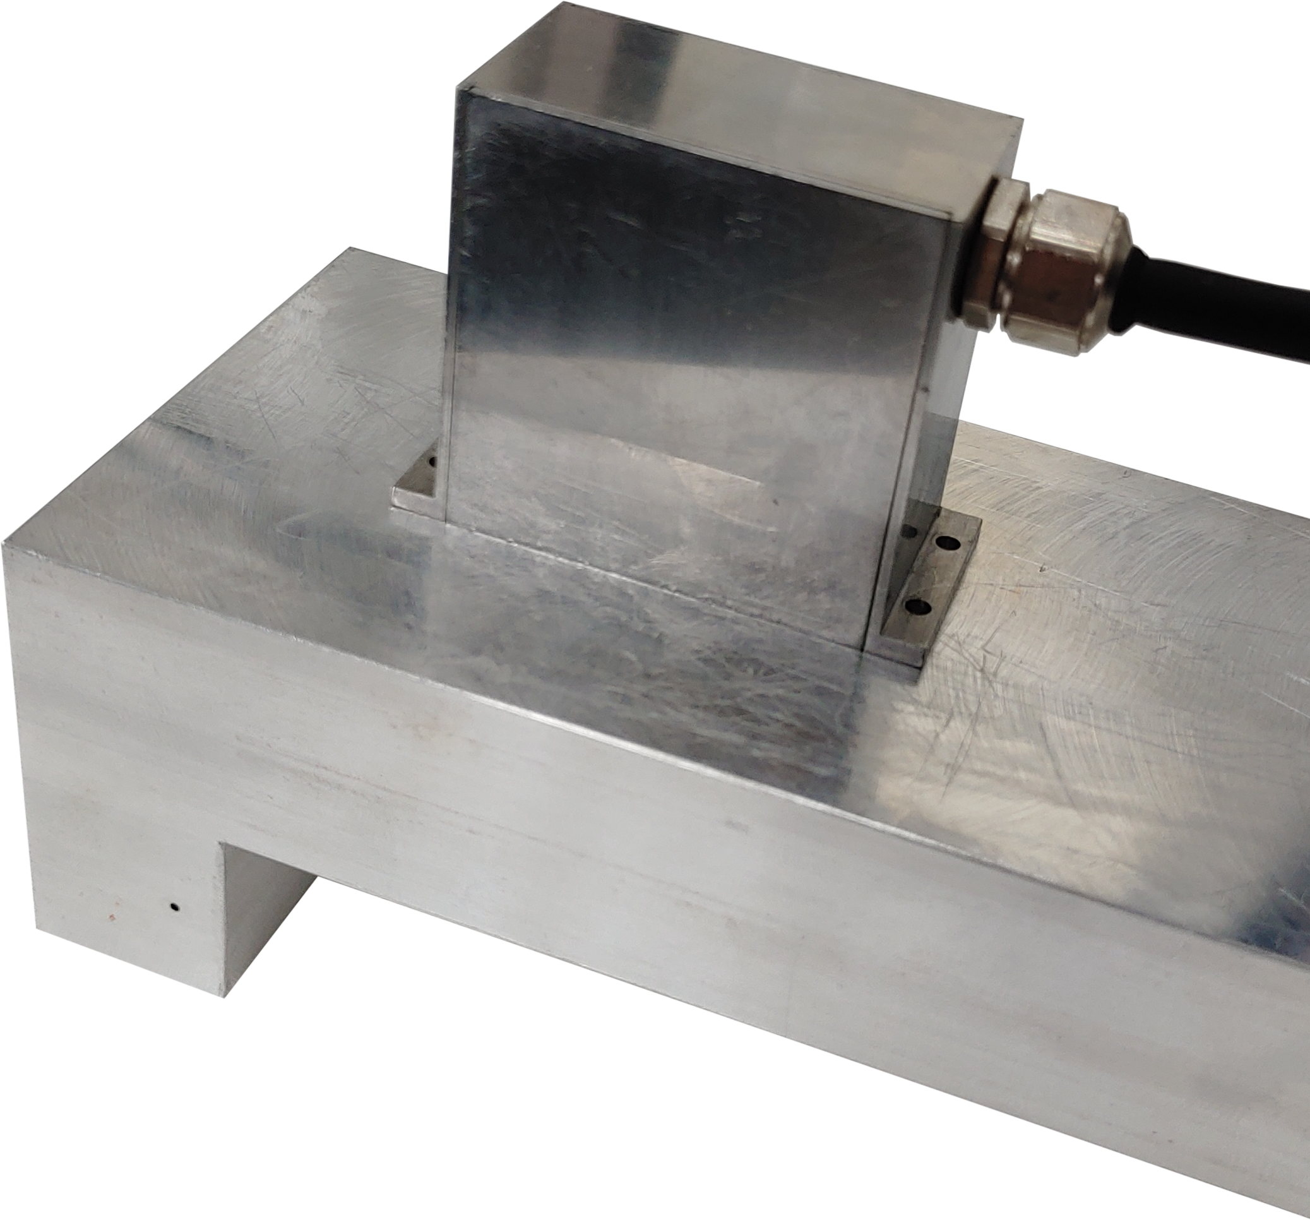
Statistical Framework
Probability maps
No SDH
45mm
SDH
25mm
[3] | Chandler, M. G. et al., NDT & E Int. 142, 103014 (2024)
3

Slide 5
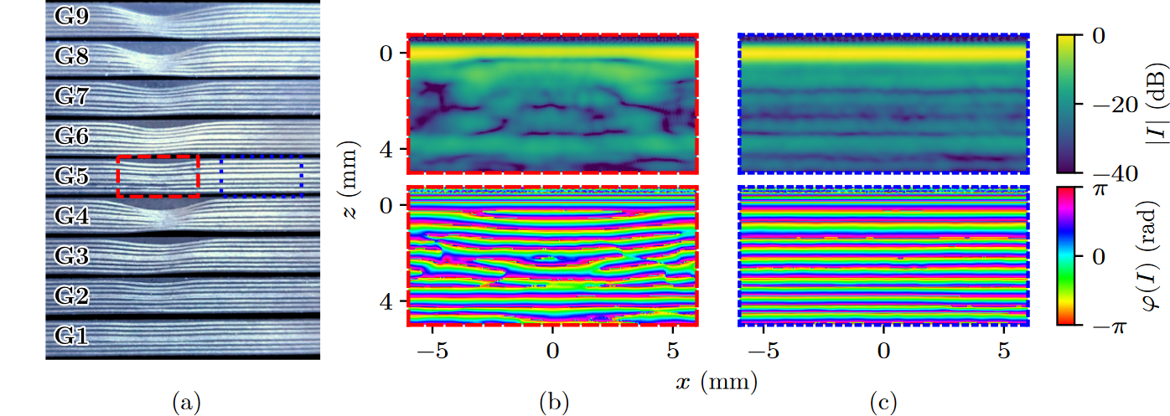
Wrinkling in CFRP
Interfaces between layers in CFRP act as reflectors of the ultrasonic signal. Regular structure produced in TFM images, which changes when structure is wrinkled.
4

Slide 6
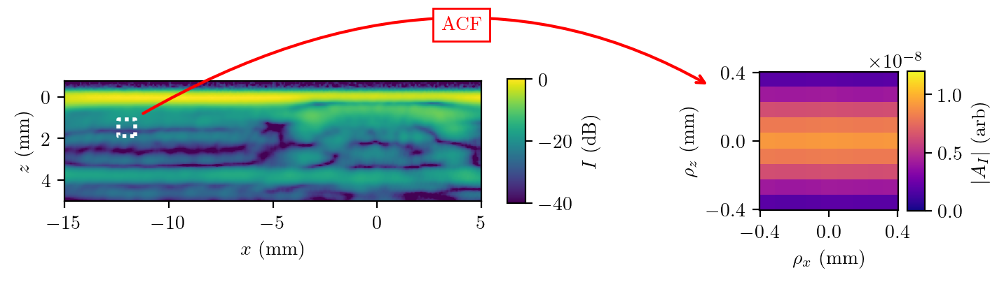
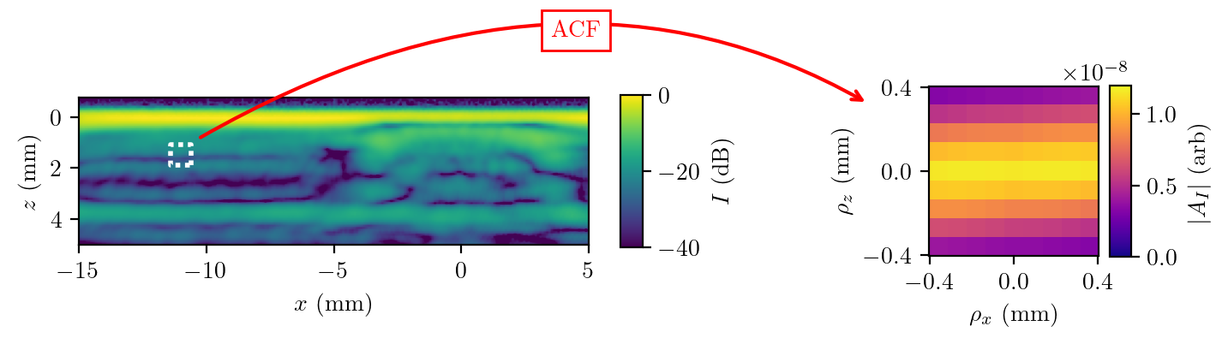

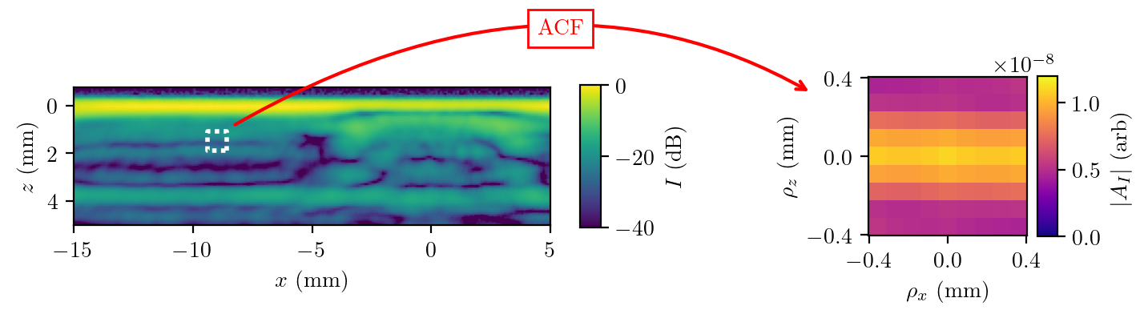
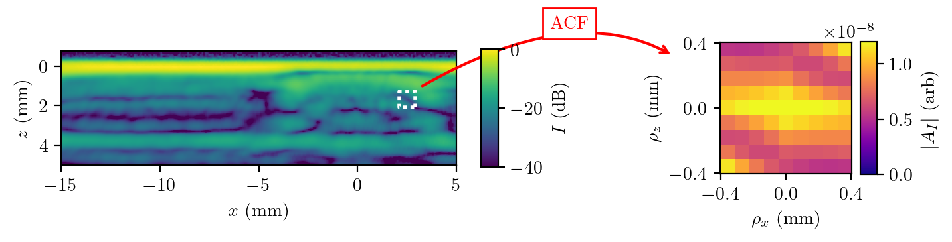

Autocorrelation
Expect intensity to be highly correlated between layers.
$$A_{I}\left(ρ\right)=\frac{1}{M}\sum_{r}{I\left(r\right)∙\overline{I\left(r+ρ\right)}}$$
5

Slide 7
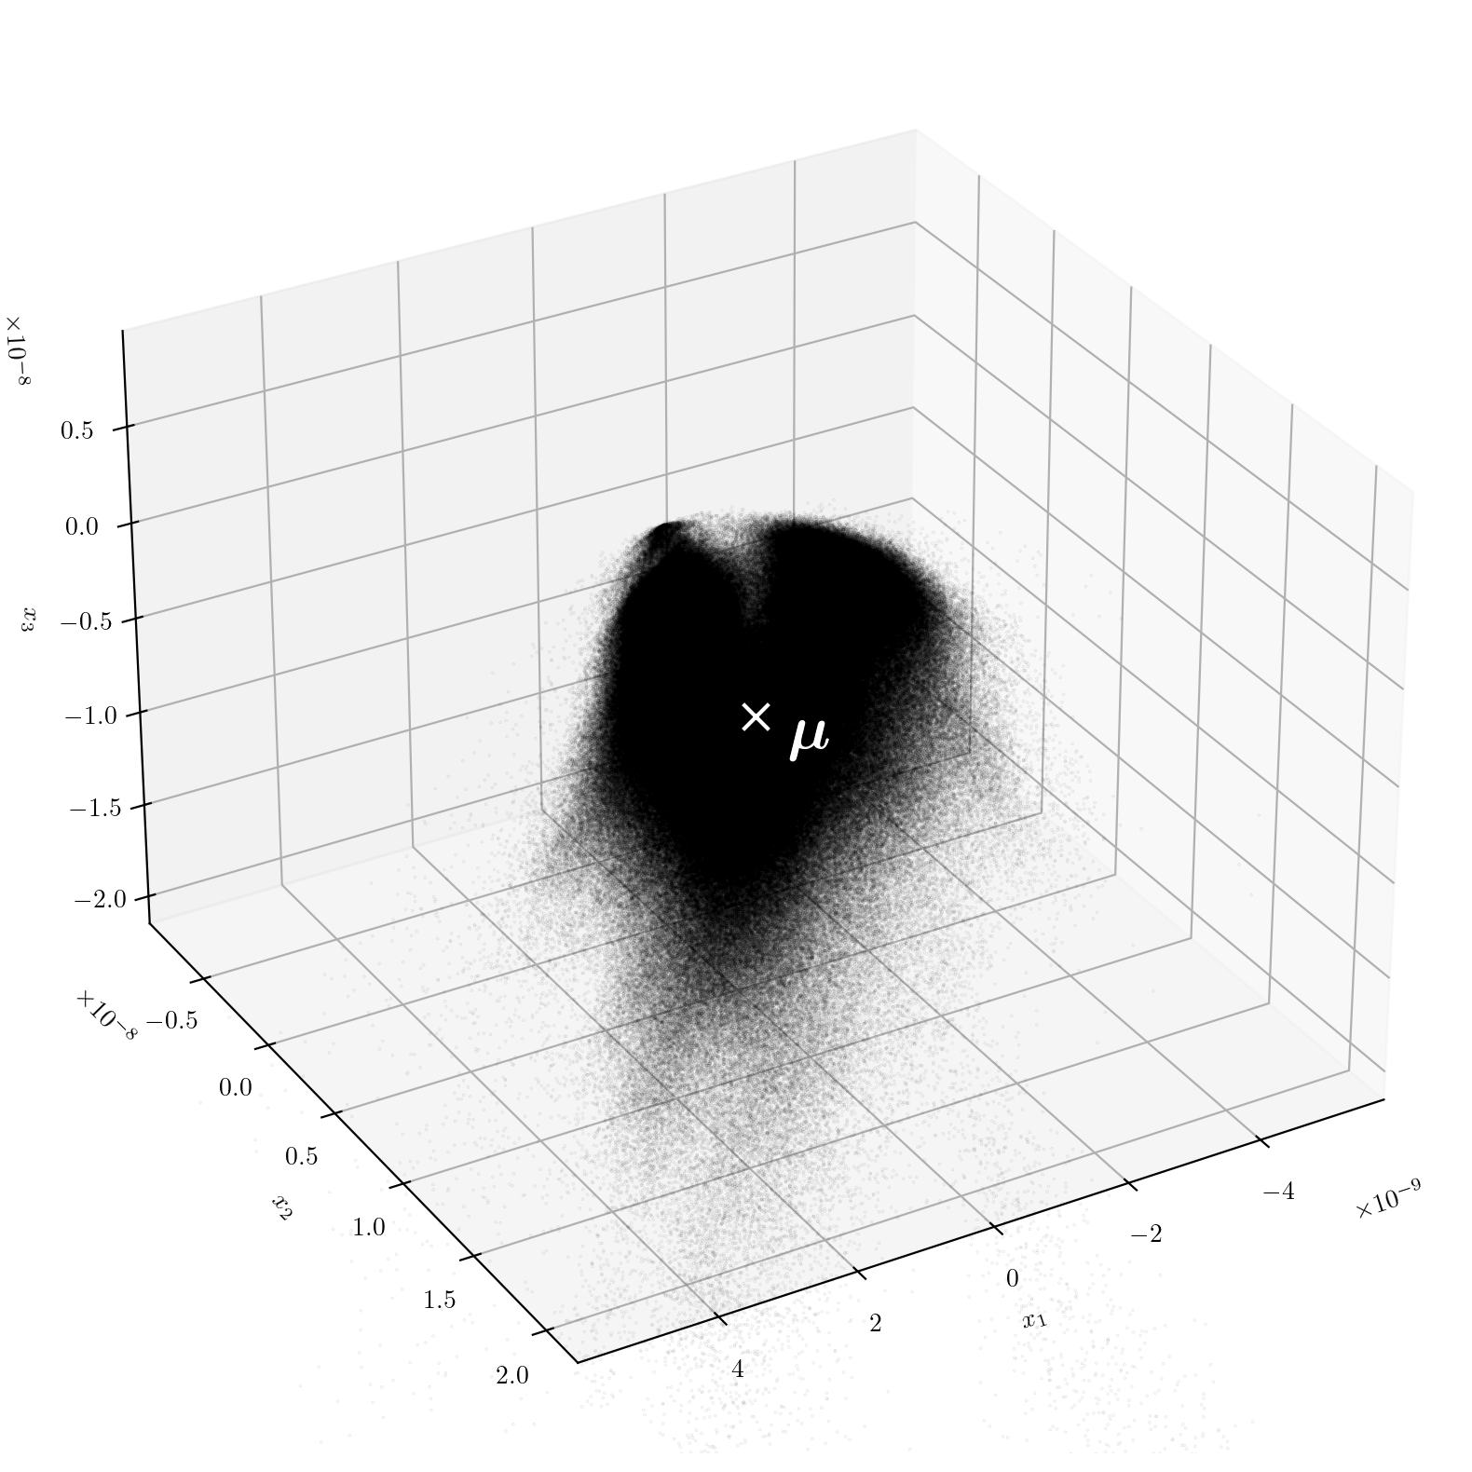
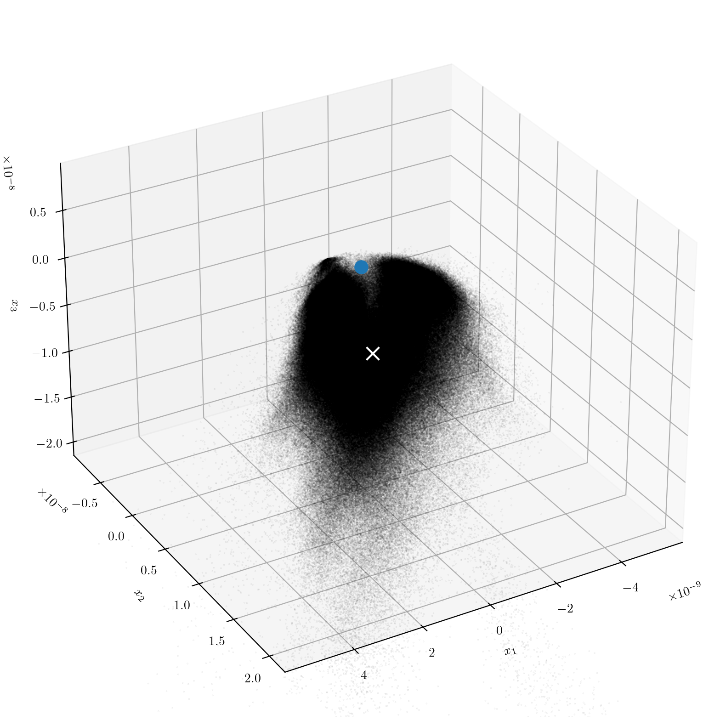
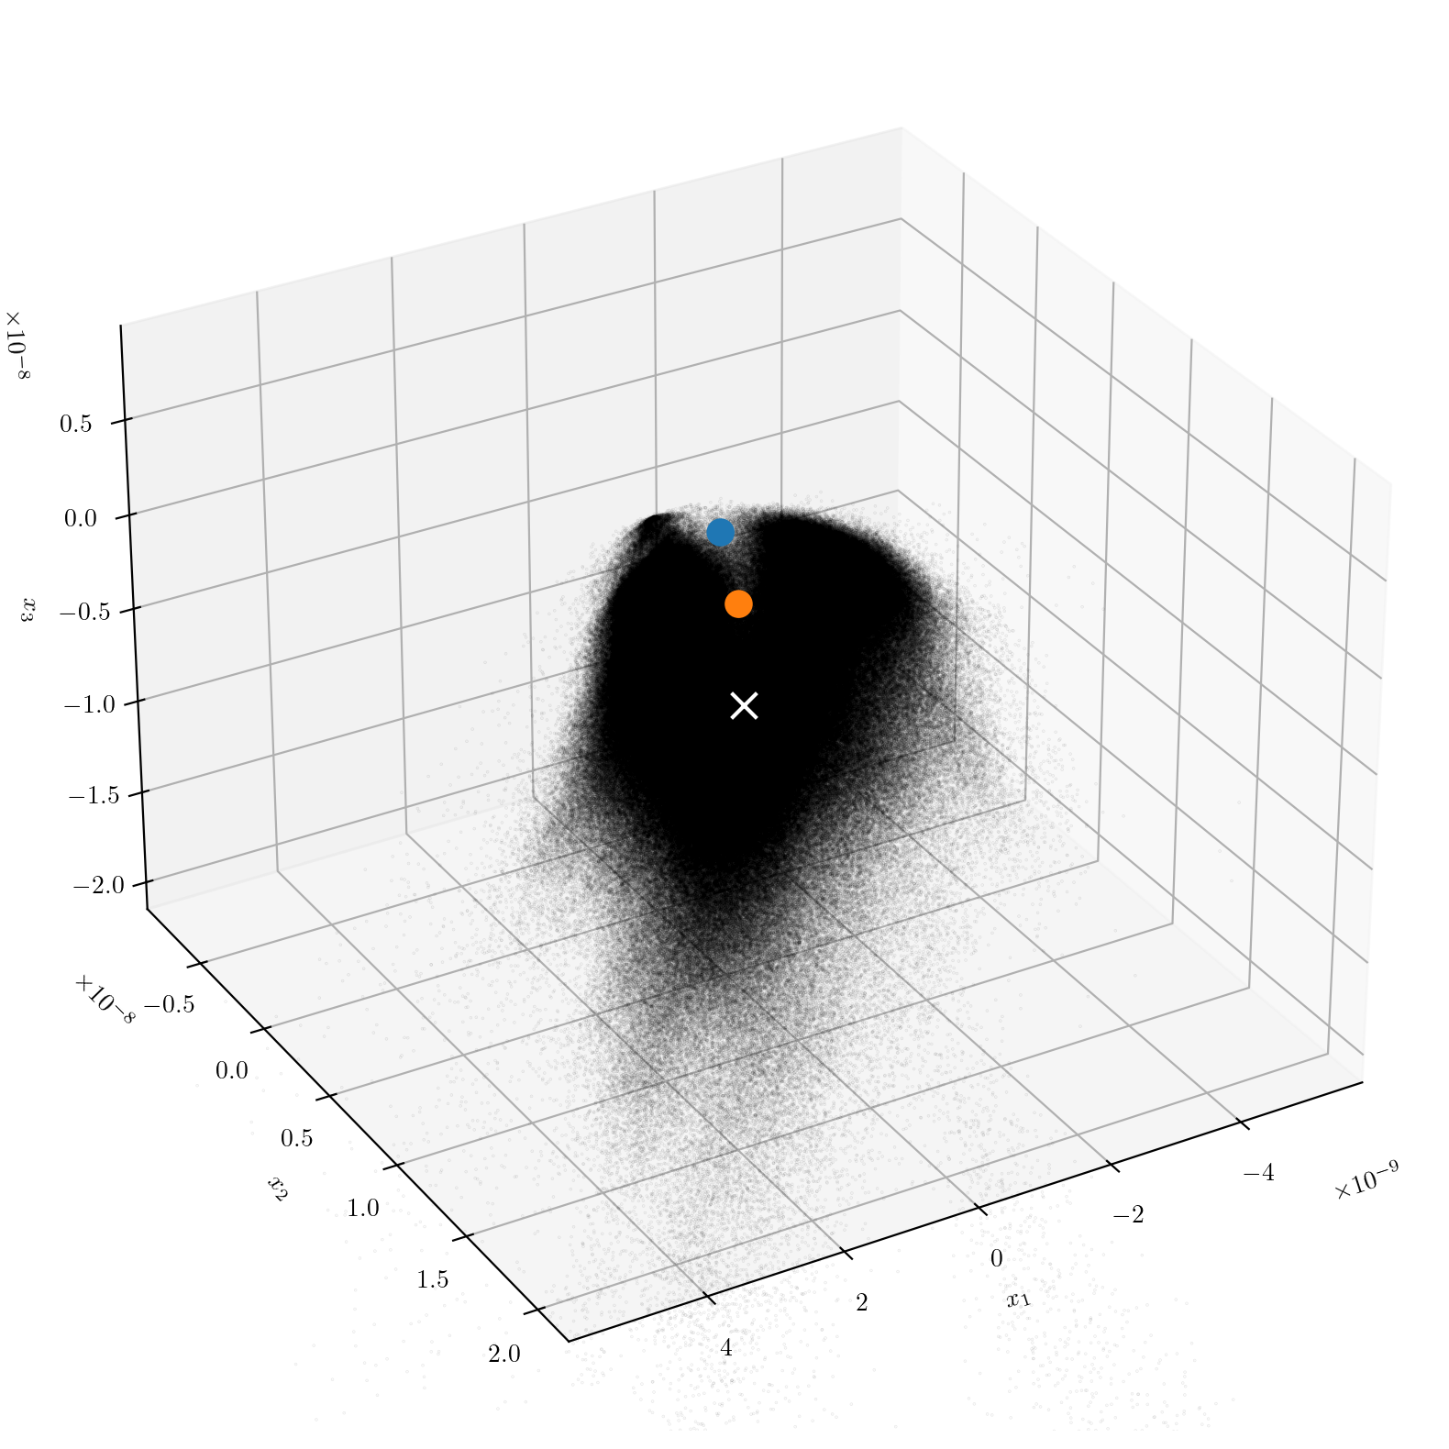
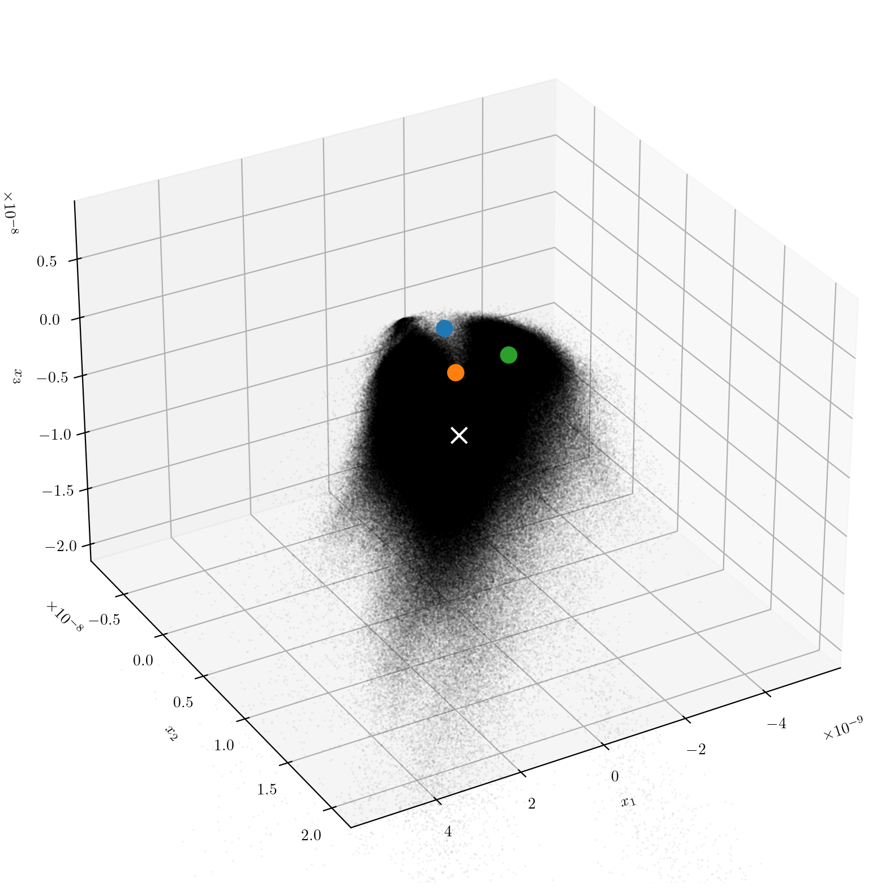
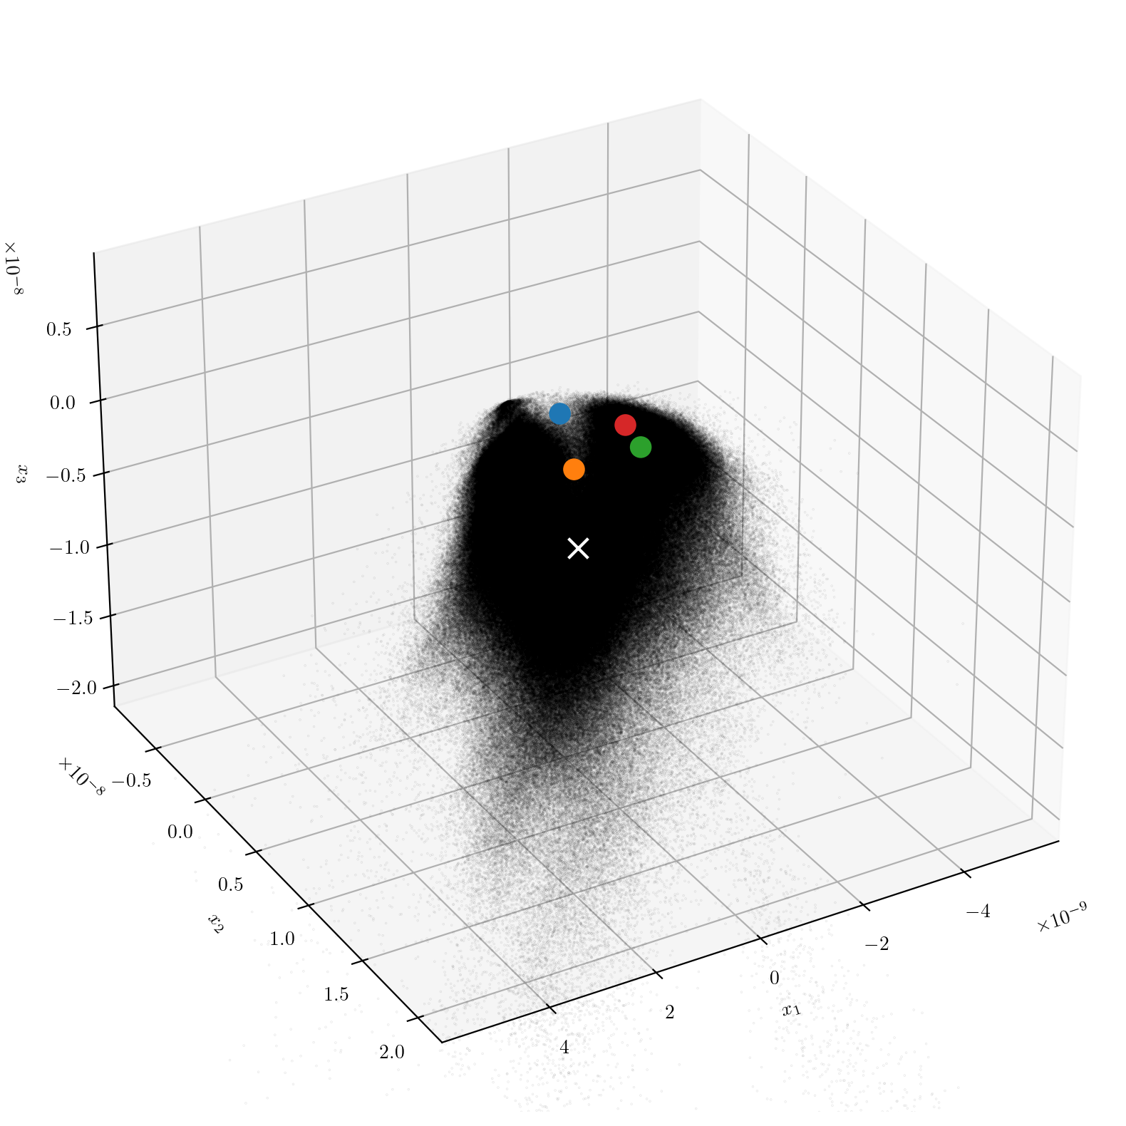
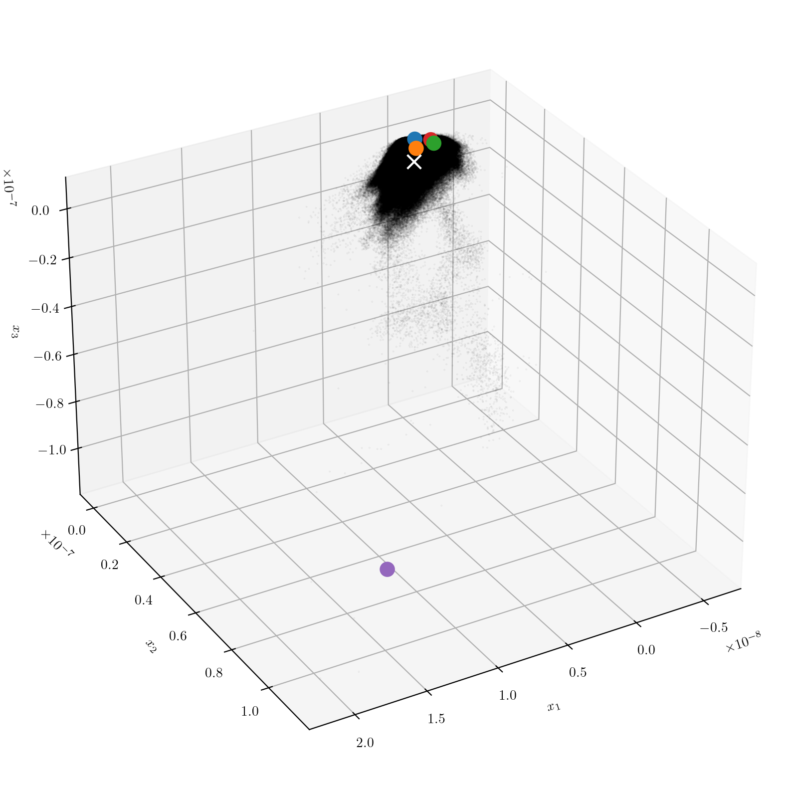
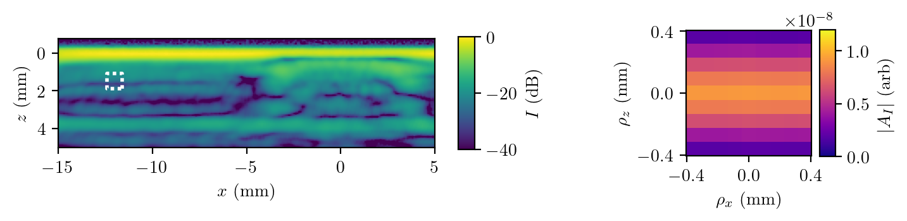
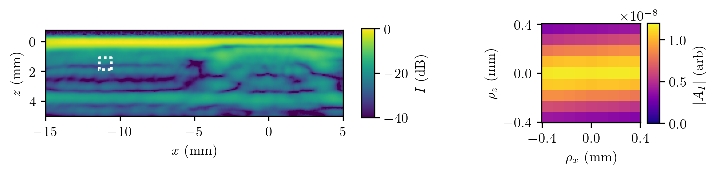
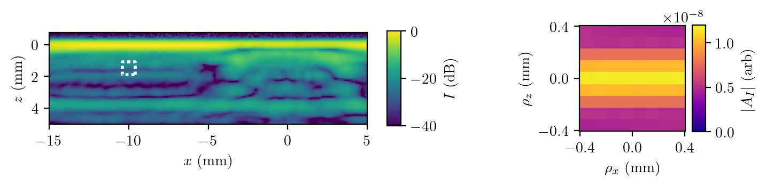
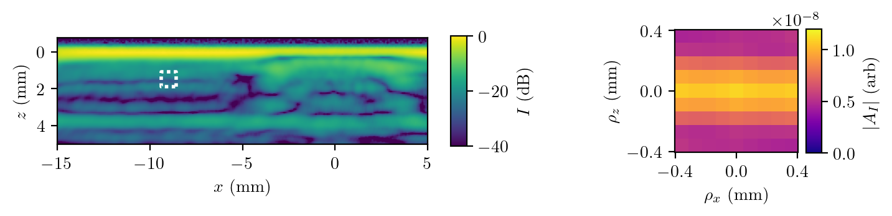
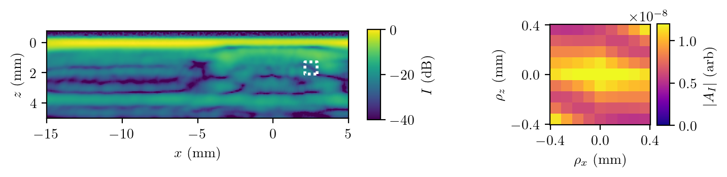

Multivariate Hypothesis Testing
Model $A_{I}\left(ρ\right) \sim 𝒩_{k}\left(μ,Σ\right)$, and perform hypothesis testing.
6

Slide 8


Multivariate Hypothesis Testing
Compute normalised distance from the mean
$$s^{2}=\left(x−μ\right)Σ^{−1}{\left(x−μ\right)}^{∗}$$
Model $A_{I}\left(ρ\right) \sim 𝒩_{k}\left(μ,Σ\right)$, and perform hypothesis testing.
$$s$$
6

Slide 9
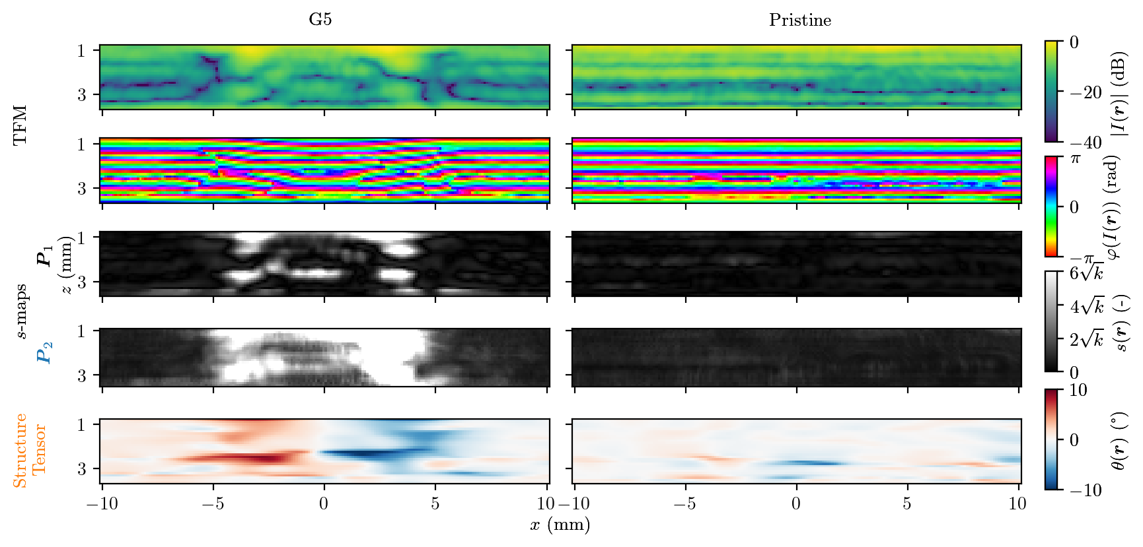
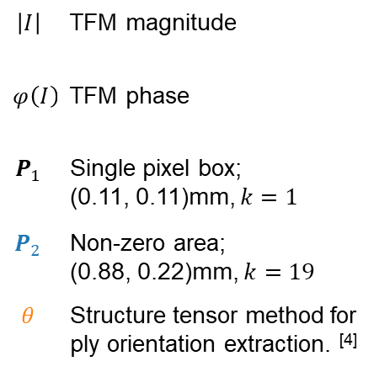
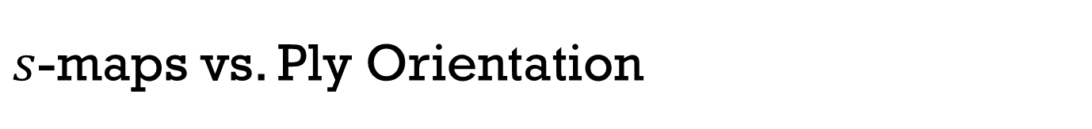
$s$-maps vs. Ply Orientation
$$\left|I\right|$$ | TFM magnitude
$$φ\left(I\right)$$ | TFM phase
$$P_{1}$$ | Single pixel box; (0.11, 0.11)mm, $k=1$
$$P_{2}$$ | Non-zero area; (0.88, 0.22)mm, $k=19$
$$θ$$ | Structure tensor method for ply orientation extraction. ^{[4]}
[4] | Nelson, L. J. et al., Composites A, 104, 108-119 (2018)
7

Slide 10
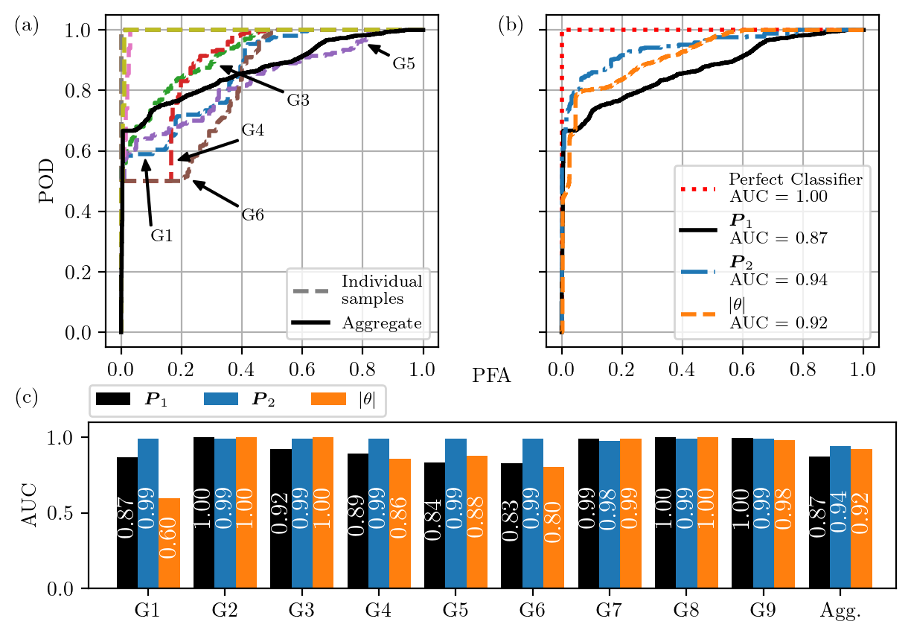
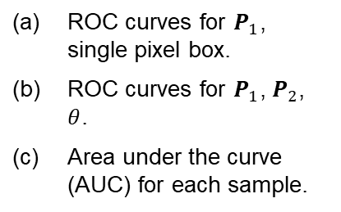
Performance Evaluation
(a) | ROC curves for $P_{1}$, single pixel box.
(b) | ROC curves for $P_{1}$, $P_{2}$, $θ$.
(c) | Area under the curve (AUC) for each sample.
8

Slide 11
Conclusions
Improvements made to previous work on detection in geometrically- and structurally complex materials.
Evaluation of area shown to improve detection in materials which are highly scattering.
Pristine data must sample all acceptable variation – array position, temperature, material variations, minimum acceptable flaw.
9

Slide 12
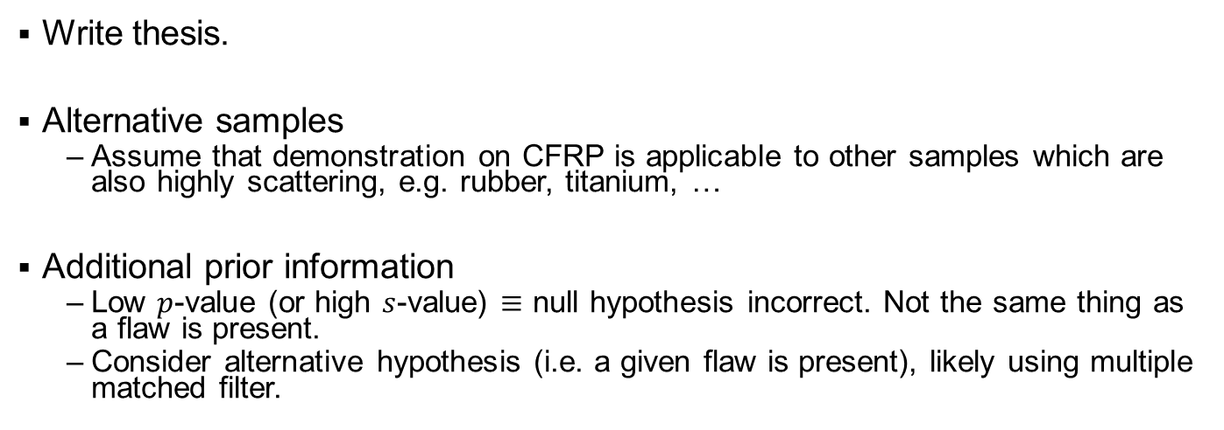
Future Work
Write thesis.
Alternative samples
  Assume that demonstration on CFRP is applicable to other samples which are also highly scattering, e.g. rubber, titanium, …
Additional prior information
  Low $p$-value (or high $s$-value) $≡$ null hypothesis incorrect. Not the same thing as a flaw is present.
  Consider alternative hypothesis (i.e. a given flaw is present), likely using multiple matched filter.
10

Slide 13


Questions?
✉
m.chandler@bristol.ac.uk
/in/mgchandler
/mgchander

